Slide 1
TGB-Seq Benchmark: Challenging Temporal GNNs with Complex Sequential Dynamics
Lu Yi, Jie Peng, Yanping Zheng*, Fengran Mo, Zhewei Wei*
Yuhang Ye, Zixuan Yue, Zengfeng Huang
Renmin University of China
Contact: yilu@ruc.edu.cn

Slide 2
Overview
TL;DR: A challenging benchmark for future link prediction, emphasizing complex sequential dynamics
Outline
Background on temporal graphs and temporal GNNs
Limitations of existing methods and datasets
TGB-Seq benchmark
Benchmarking results on TGB-Seq

Slide 3
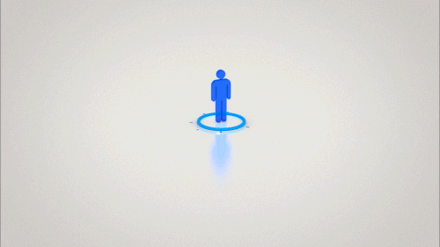
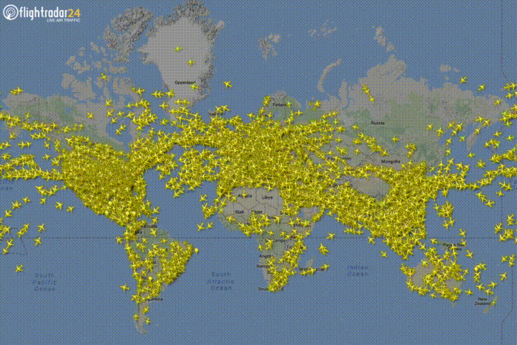
Temporal Graphs
Temporal/Dynamic graphs: edges and nodes evolve over time
Social networks: new users join, connections between users form
Recommendation networks: users purchase and review products
2
2
2
1
3
1
3
1
3
4
4
…
4
6
6
6
5
5
5
7
7
7
$$t$$

Slide 4
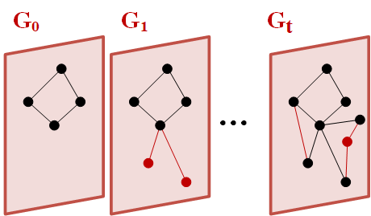
Temporal Graphs Categories
Discrete-time temporal graphs
$A stream of graph snapshot$s: $\left\{G_{1},G_{2},…,G_{T}\right\}$ $G_{i}=(V_{i},E_{i})$
Continuous-time temporal graphs
A stream of edges: $\left\{\left(s_{0},d_{0},t_{0}\right),\left(s_{1},d_{1},t_{1}\right),⋯,\left(s_{T},d_{T},t_{T}\right)\right\}$
$$t_{1}$$
$$i_{1}$$
$$u_{1}$$
$$t_{2}$$
$$i_{2}$$
$$u_{2}$$
$$t_{1}$$
$$t_{5}$$
$$i_{3}$$
$$u_{3}$$
$$t_{2}$$
$$t_{4}$$
$$i_{4}$$
$$t_{3}$$
$$u_{4}$$
$$i_{5}$$

Slide 5
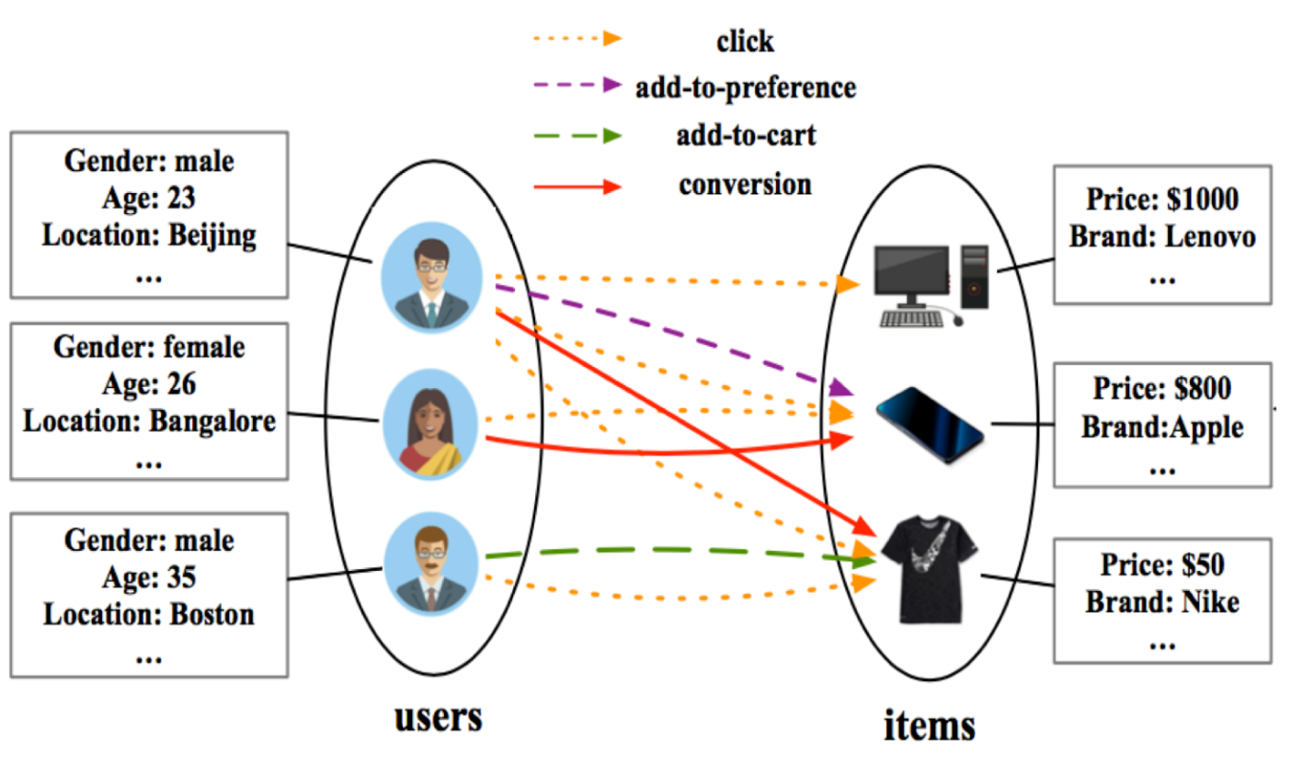
Tasks of Temporal GNNs
Future link prediction
Given $G$, $\left(s,d,t\right) and E$ before $t$, the model is asked to predict the likelihood of the edge $(s,d)$ appearing at time $t$.
Ranking problem: the model is asked to rank $d$ higher among sampled $k$ nodes.
$$t_{1}$$
$$i_{1}$$
$$u_{1}$$
$$t_{2}$$
$$i_{2}$$
$$u_{2}$$
$$t_{1}$$
$t_{5}$?
$$i_{3}$$
$$u_{3}$$
$$t_{2}$$
$$t_{4}$$
$$i_{4}$$
$$t_{3}$$
$$u_{4}$$
$$i_{5}$$
future link prediction

Slide 6
Temporal GNNs
Existing methods = memory module + aggregation module
Aggregate history
Memory update
Predict
$t_{5}$? 0.8
$$t_{5}$$
$t_{6}$? 0.1
$$t_{6}$$
self
neighbors
$$t_{5}$$
$$t_{2}$$
$$t_{3}$$
$$t_{7}$$
$$t_{8}$$
···
Batch data
$$t_{5}$$
$$t_{2}$$
$$t_{3}$$
$$t_{9}$$
$$t_{11}$$
···
High-order correlation computaton
$$t_{6}$$
$$t_{3}$$
$$t_{3}$$
$$t_{5}$$
$$t_{8}$$
···
$$t_{6}$$
$$t_{5}$$
$$t_{6}$$
$$t_{7}$$
$$t_{8}$$
···
Interaction Database
Method | Memory | Aggregation | High-order
TGN | GRU | Attention | /
EdgeBank | Record all histories | / | /
DyGFormer | / | Attention | Co-neighbors frequency

Slide 7
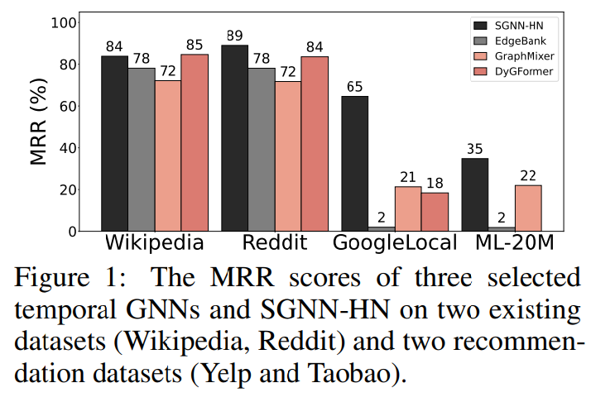
Motivations
Observation 1. Temporal GNNs excel in predicting seen edges but struggle to generalize to unseen edges.
Observation 2. Temporal GNNs fail to perform effectively on recommendation datasets, a typical downstream application.

Slide 8
Existing dataset
Excessive repeated historical edges ➔ Memorizing historical edges
Existing datasets
Existing temporal GNNs
EdgeBank:
$$u_{1}$$
$$a$$
$$a$$
$$a$$
$$b$$
$$b$$
node
$$u_{1}$$
$$u_{2}$$
$$u_{3}$$
$$u_{4}$$
$$u_{2}$$
$$c$$
$$c$$
$$c$$
memory
$$a$$
$$b$$
$$c$$
$$a$$
$$c$$
$$d$$
$$a$$
$$u_{3}$$
$$a$$
$$a$$
$$c$$
$$c$$
DyGFormer
$$u_{4}$$
$$d$$
$$d$$
$$a$$
$$a$$
3 times
0 times
$$t$$
$$u_{1}$$
$$a$$
$$u_{1}$$
$$d$$
$$t_{1}$$
$$t_{2}$$
$$t_{3}$$
$$t_{4}$$
$$t_{5}$$
$$t_{6}$$
$u_{1}$ is more likely to interact with $a$ instead of $d$.

Slide 9
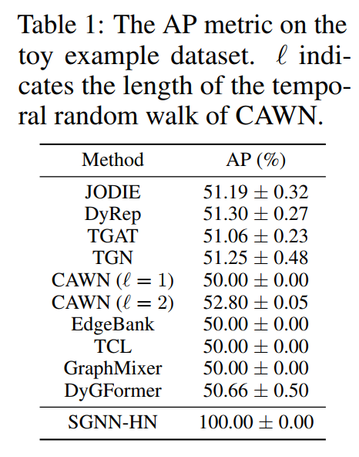
Current pitfalls in temporal GNNs
Toy example:
$$q$$
query node
$$t_{T−4}$$
$${t_{T}}_{ }?$$
$${t_{T}}_{ }?$$
$$t_{T−2}$$
$$t_{T−1}$$
$$t_{T−3}$$
$$i_{0}$$
$$i_{1}$$
$$i_{2}$$
$$i_{3}$$
$$i_{4}$$
$$i_{5}$$
$$i_{6}$$
$$i_{7}$$
$$i_{8}$$
$$i_{9}$$
$$t_{0}$$
$$t_{5}$$
$$t_{1}$$
$$t_{6}$$
$$t_{7}$$
$$t_{8}$$
$$t_{9}$$
$$t_{0}$$
$$t_{5}$$
$$t_{1}$$
$$t_{6}$$
$$t_{7}$$
$$t_{8}$$
$$t_{9}$$
$$t_{2}$$
$$t_{3}$$
$$t_{4}$$
$$t_{2}$$
$$t_{3}$$
$$t_{4}$$
$$u_{0}$$
$$u_{1}$$
$$u_{2}$$
……
$$v_{0}$$
$$v_{1}$$
$$v_{2}$$
……
Results:
All methods failed to rank $i_{4}$ higher than $i_{9}$.

Slide 10
Analysis of the Pitfall
Memory module→ identical memory
Aggregation module→ identical embedding
High-order correlation module→ help little, too much noise
All modules cannot distinguish $i_{4}$ and $i_{9}$ → fail to capture the sequential dynamics.

Slide 11
Sequential dynamics are everywhere!
Movie watching
Social networks
E-commerce
$$t$$
Understanding complex sequential dynamics is the key.

Slide 12
Existing datasets
High repeat ratio $r=\left|ℇ_{seen}\right|/|ℇ|$
Too simple sequential dynamics
We need more challenging datasets.

Slide 13
TGB-Seq: new benchmark
low repeat ratio $r=\left|ℇ_{seen}\right|/|ℇ|$
diverse domains representing typical real-world applications of future link prediction
follow power-law degree distributions
medium to large scale

Slide 14
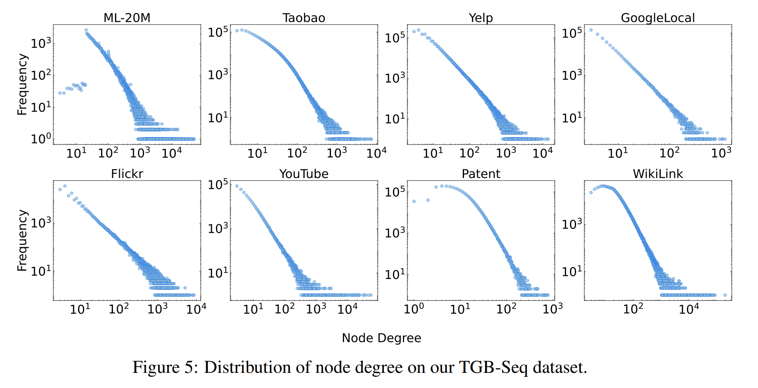
Node Degree Distribution

Slide 15
MRR on Bipartite Datasets(%)
SGNN-HN (the sequential recommendation method) outperforms all temporal GNNs on all bipartite graphs!
Memory-based methods (JODIE and TGN) outperform other temporal GNNs, in contrast with their performance on the Wikipedia and Reddit dataset.
DyGFormer and CAWN outperform other temporal GNNs on Wikipedia and Reddit dataset, but fail to perform effectively on TGB-Seq bipartite datasets.

Slide 16
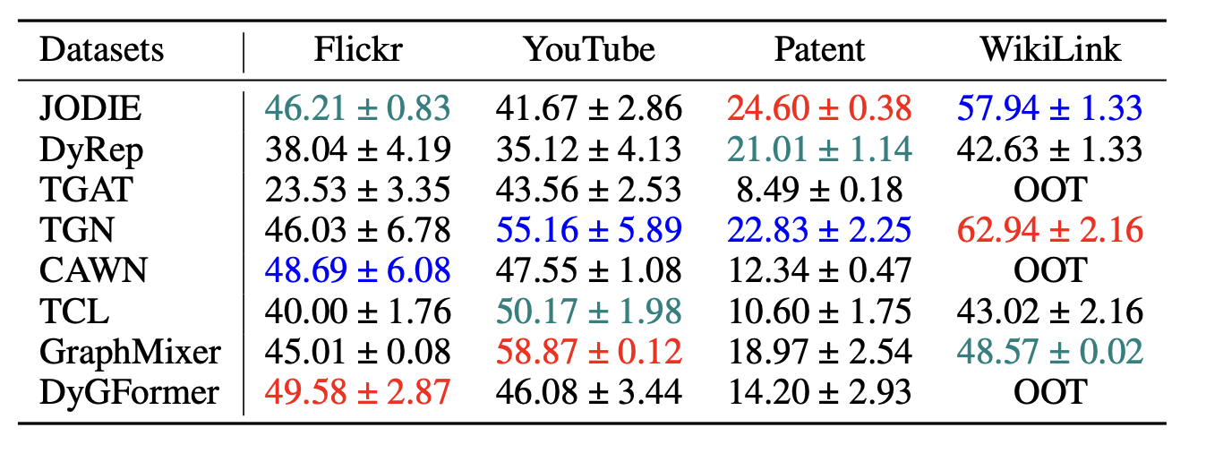
MRR on Non-bipartite Datasets(%)
On non-bipartite graphs, where SGNN-HN does not apply, performance varies.
Need more capable temporal GNNs!

Slide 17
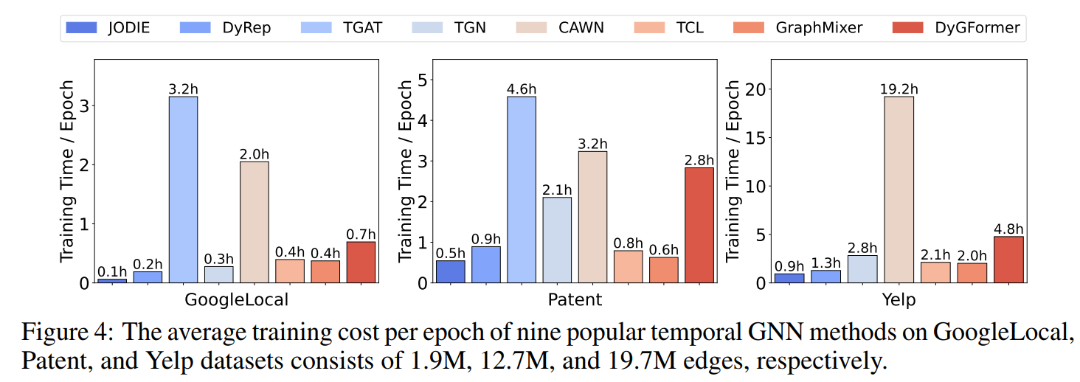
Training cost
Most efficient methods: JODIE, DyRep, GraphMixer, TCL, TGN
Inefficient methods: TGAT, DyGFormer, CAWN

Slide 18
Take away
Existing datasets: excessive repetitions of edges
➔ Existing methods: fail to capture complex sequential dynamics
TGB-Seq datasets: complex sequential dynamics, minimal repeated edges, diverse domains from real-world tasks
Benchmarking results: More capable methods are needed

Slide 19
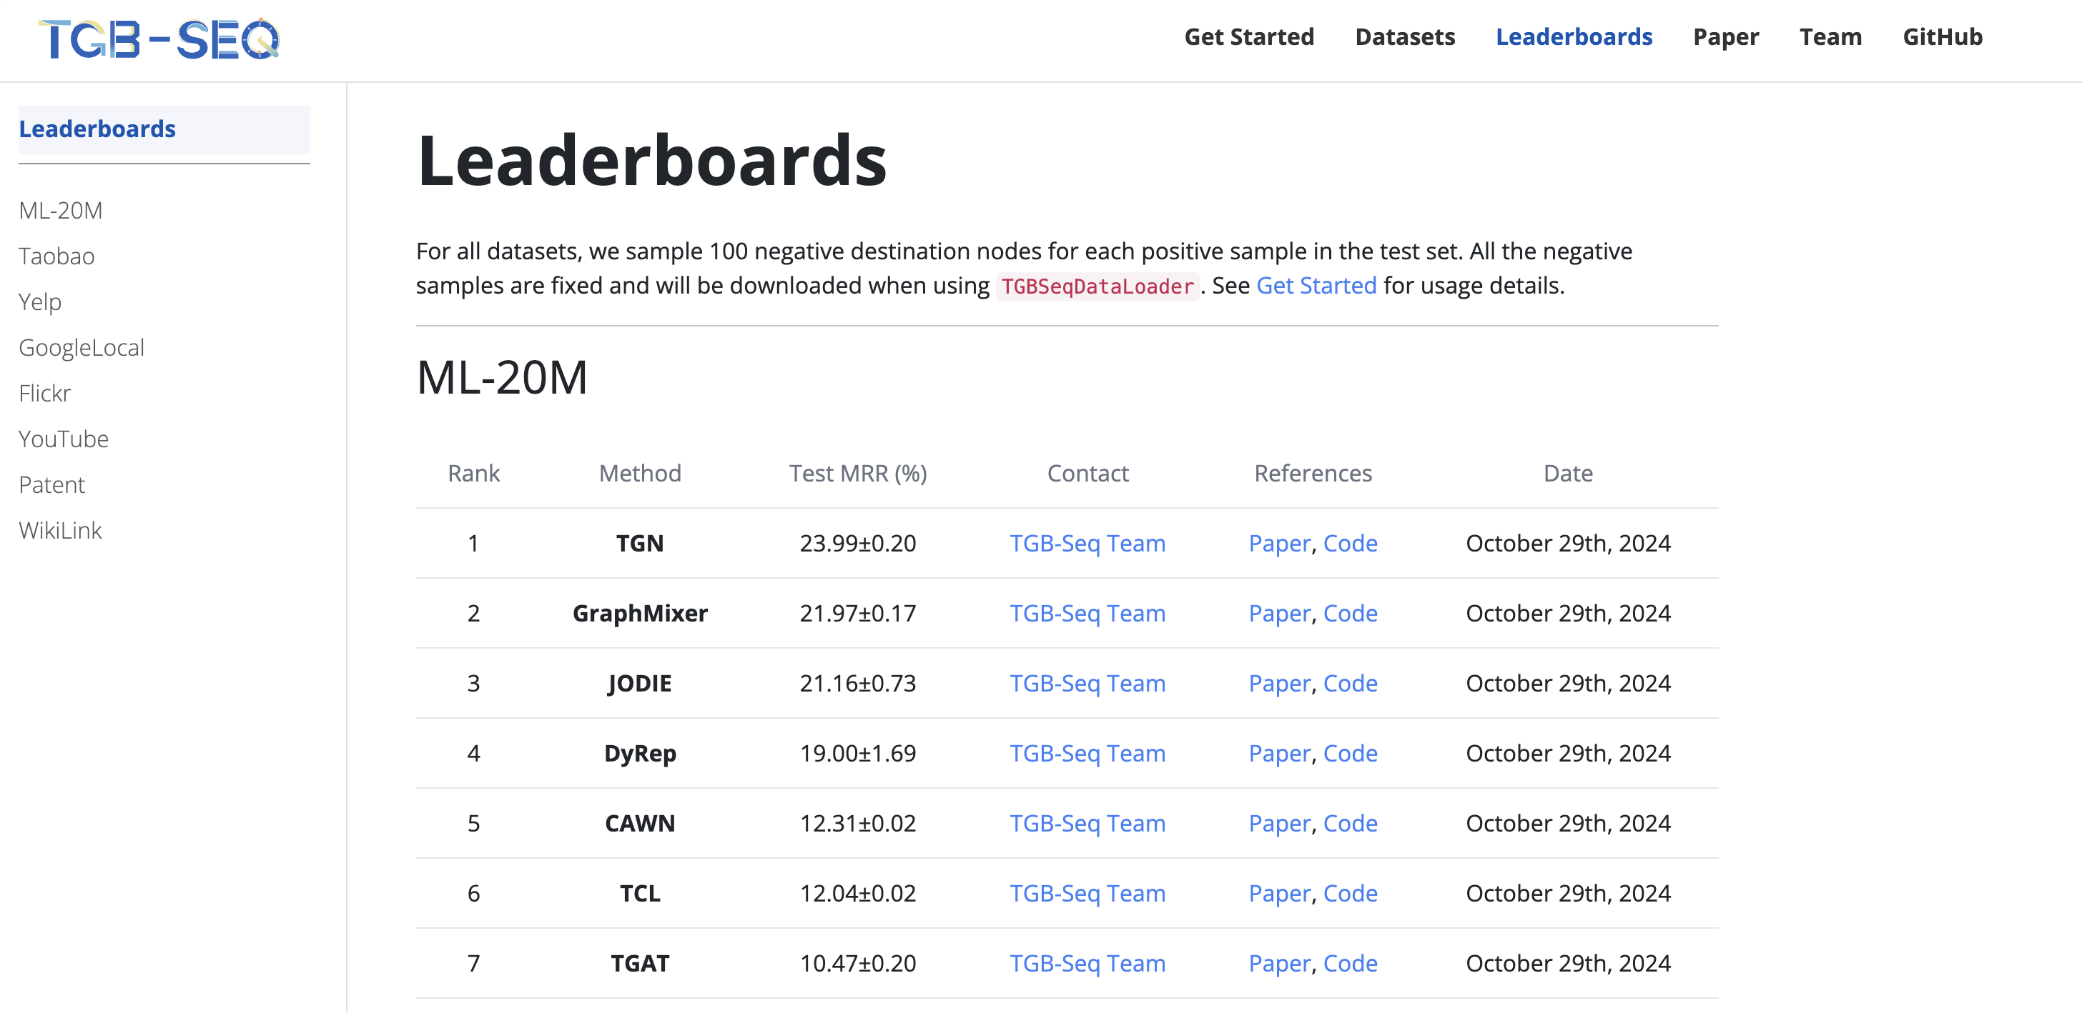
Website
Source code
Website: https://tgb-seq.github.io/, including TGB-Seq leaderboard and documentation.
pip package: pip install tgb-seq
GitHub: https://github.com/TGB-Seq/TGB-Seq.

Slide 20
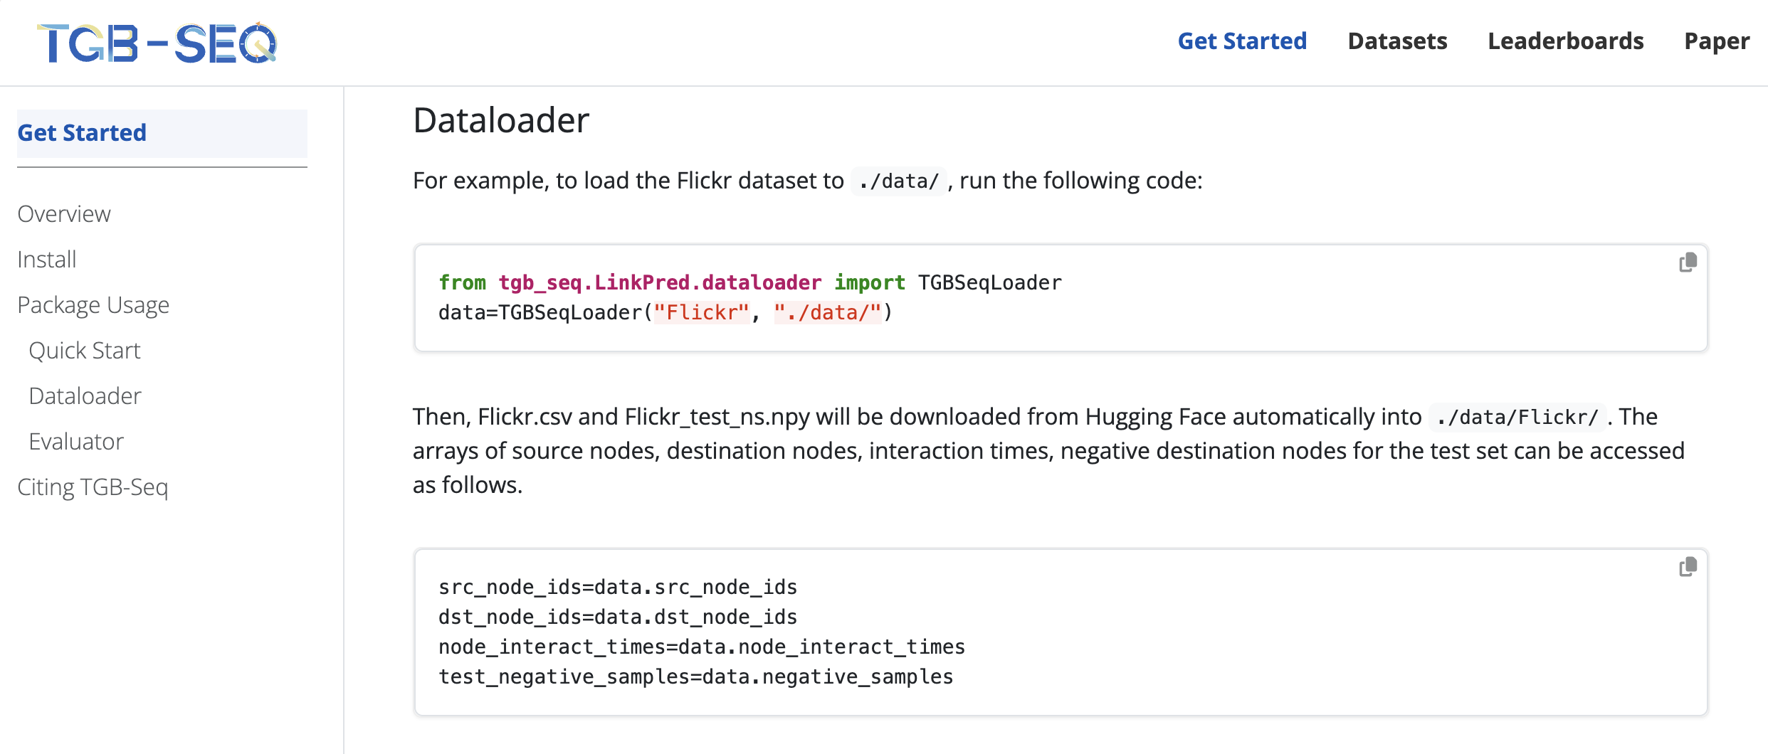
Quick Start

Slide 21
Thank you
Q&A
Any further questions or collaborations: yilu@ruc.edu.cn
My homepage: https://luyi256.github.io/
Meet me at ICLR’25
Poster Time: 4/26 15:00-17:30
Poster Position: Hall 3 + Hall 2B #184
Happy to set up another time to meet as well

